Slide 1
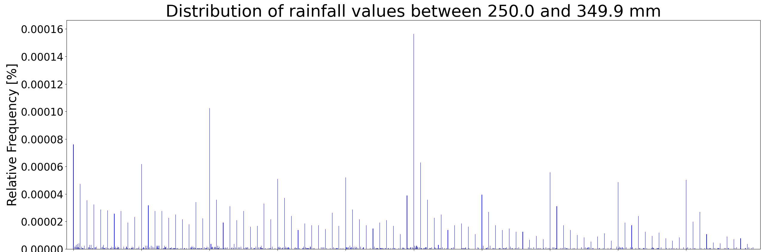
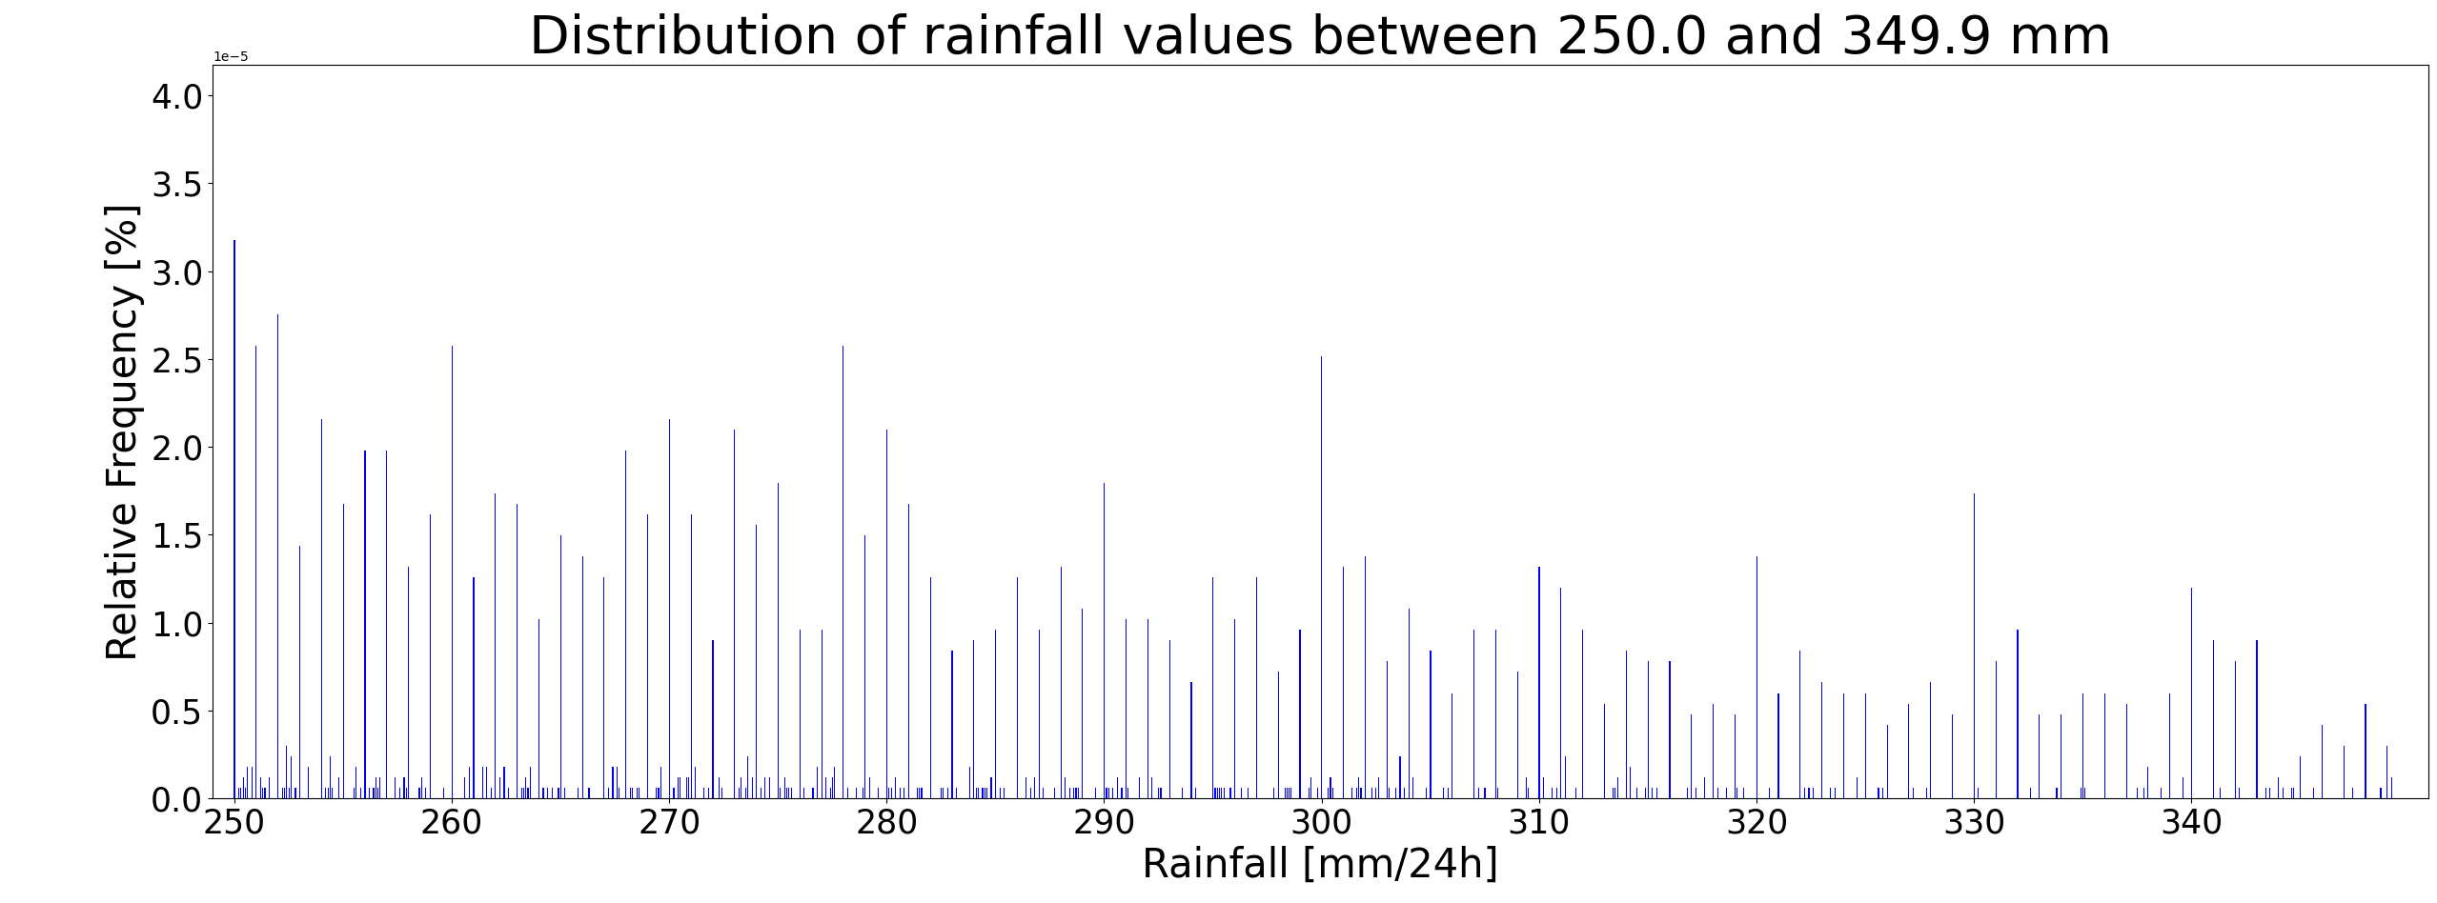
Impacts of using CPC gridded rainfall dataset to clean possible “dodgy” STVL rainfall totals
(a)
Peaks at integer values, especially at 100, 200, 300 mm, etc (figure a), have diminished after the cleaning (figure b).
(b)

Slide 2
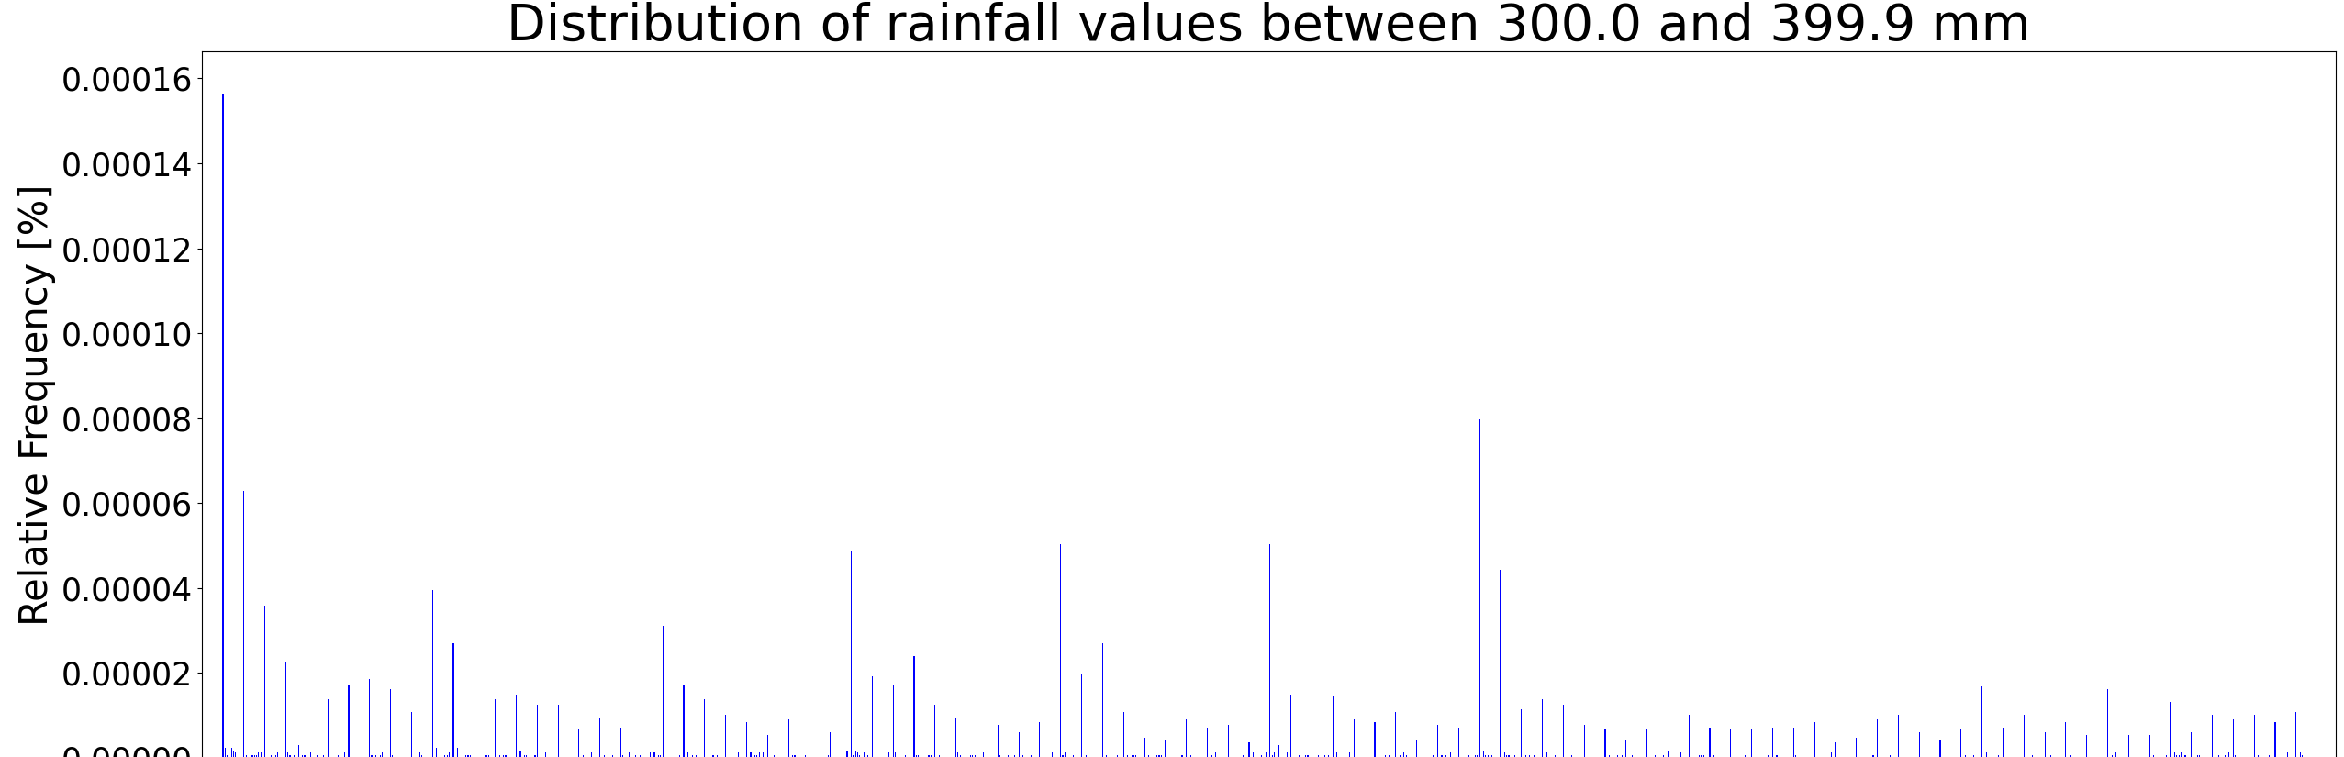
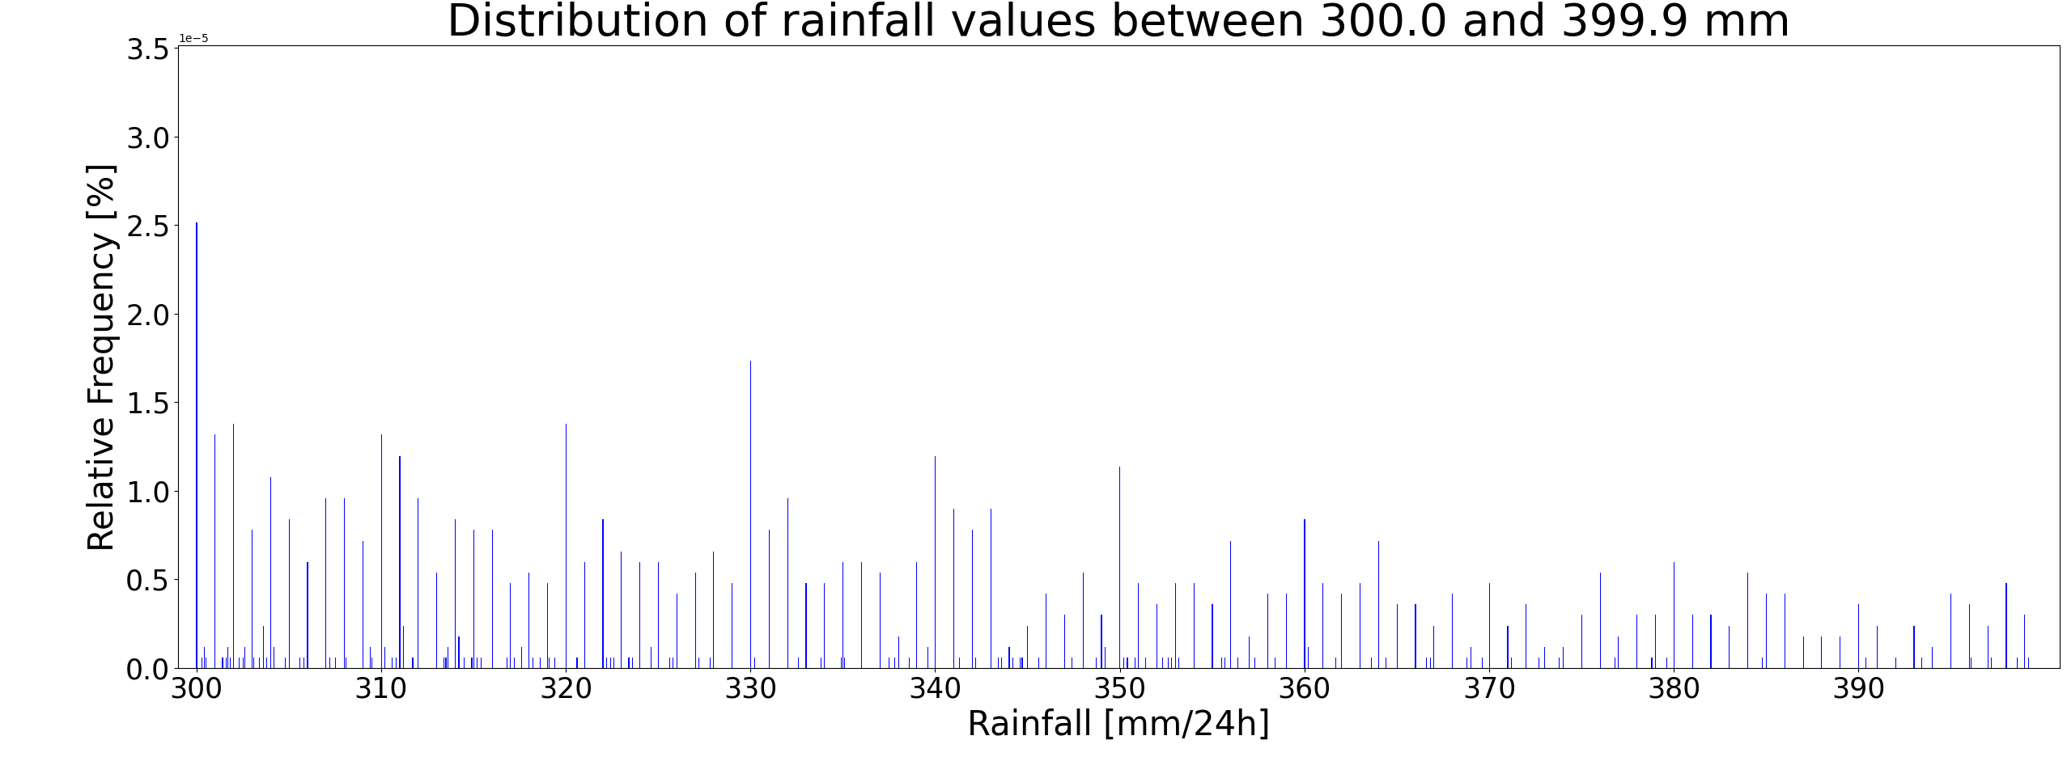
Impacts of using CPC gridded rainfall dataset to clean possible “dodgy” STVL rainfall totals
(a)
Possible unrealistic peaks at 300, 310, 320, …., up to 360 mm, coming from the possible wrong decoding as rainfall of wind direction when cloud cover is 6/8 (figure a) might have been cleaned as figure (b) shows a much smoother exponential representation of all rainfall totals.
(b)

Slide 3
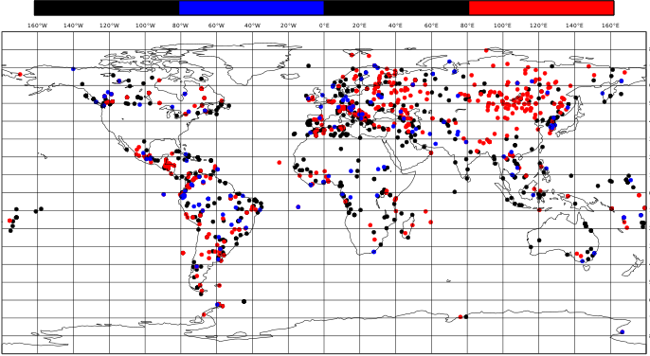
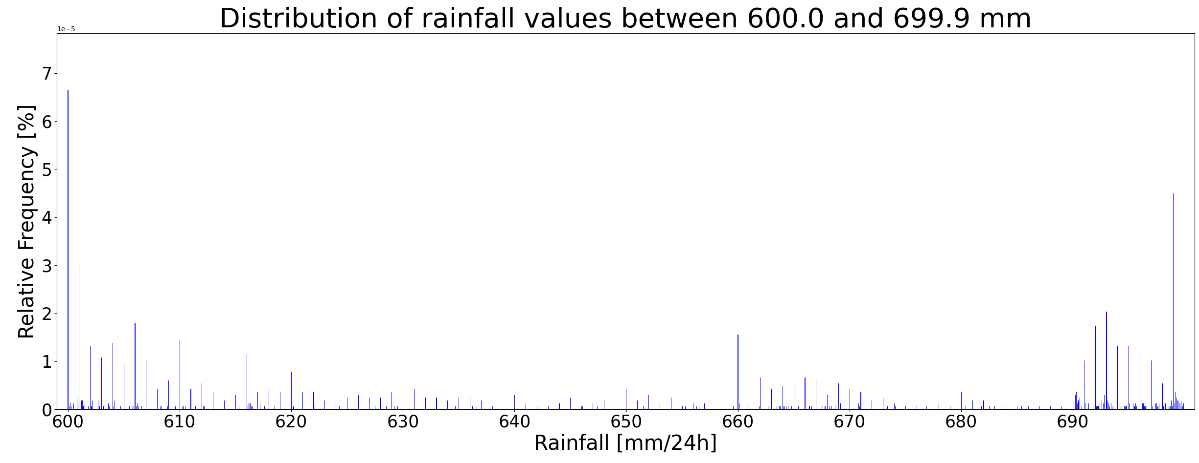
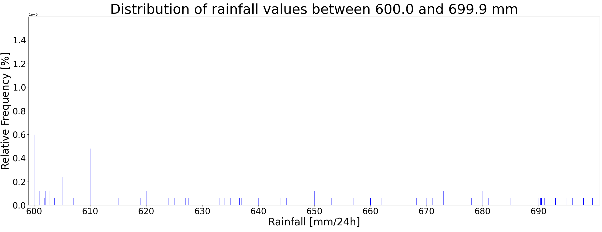
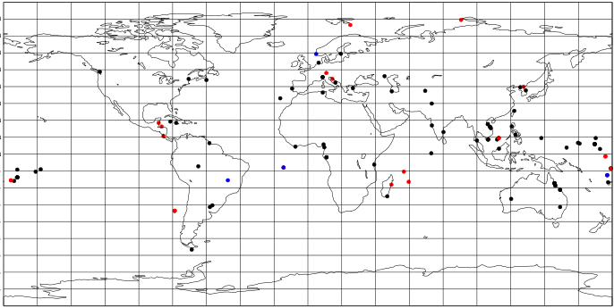
Impacts of using CPC gridded rainfall dataset to clean possible “dodgy” STVL rainfall totals
(1a)
(2a)
(1b)
(2b)
Possible unrealistic values between 600 and 699.9 mm/24h (figure a) have been removed after the cleaning, especially the ones between 660 and 669.9 mm, and 690 and 699.9 mm (figure b). Now, there seems to be a much more realistic representation of such big totals (according to online checks of regional rainfall records), with a higher frequency of such totals in the tropics than in the extra-tropics (figure 2b), especially in Canada and Europe, although also the tropics has been heavily affected by the cleaning (figure 2a). The same impact has been experienced for rainfall totals between 700 and 999.9 mm (not shown).

Slide 4
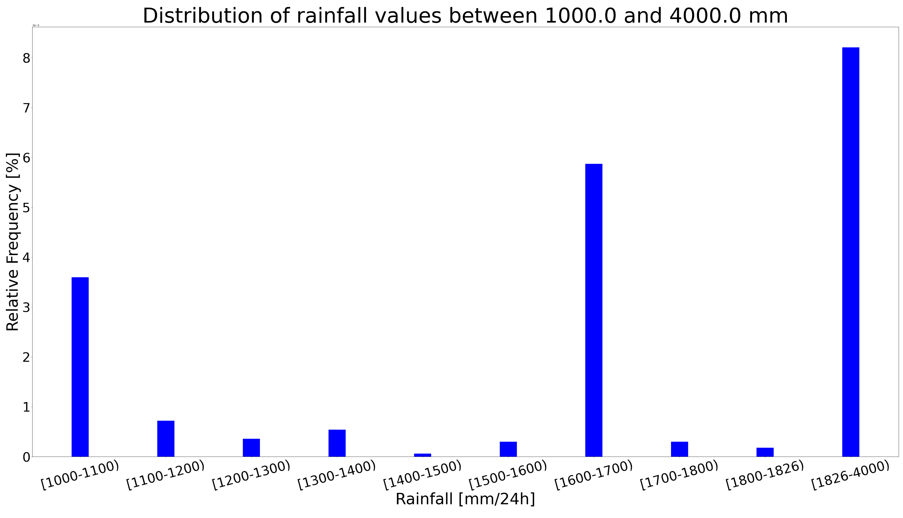
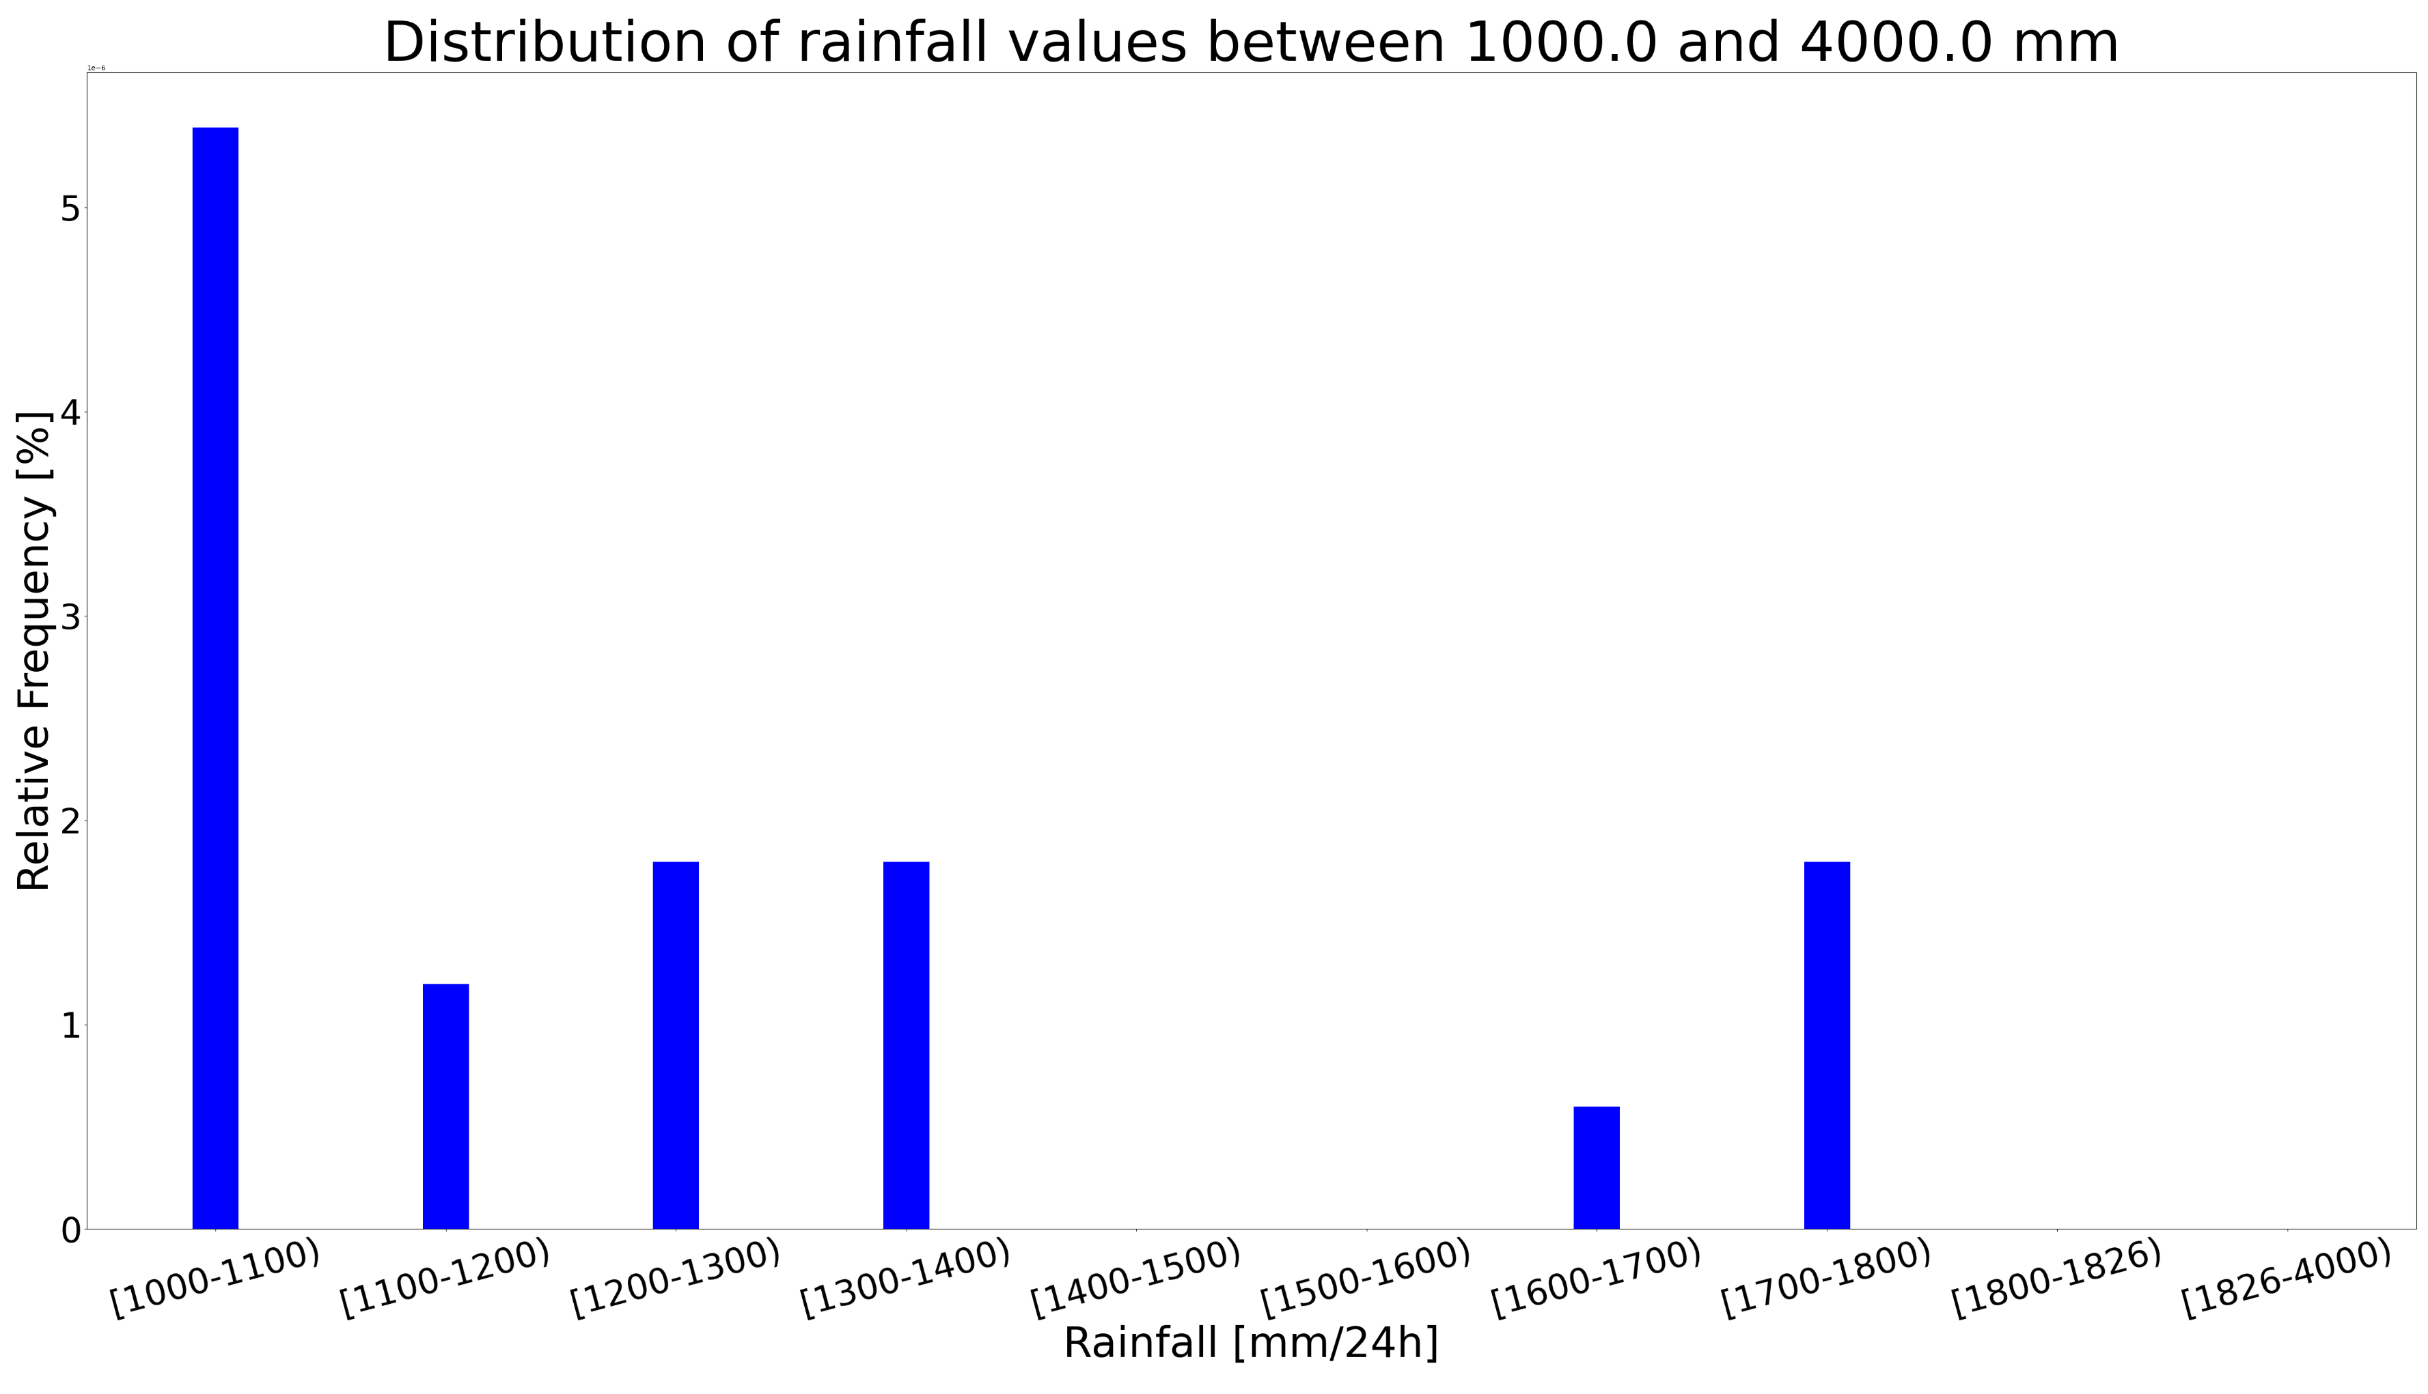
Impacts of using CPC gridded rainfall dataset to clean possible “dodgy” STVL rainfall totals
(a)
(b)
The cleaning appears to have also been able to address most of the unrealistic representation of the majority of values >= 1000 mm/24h (figure a) by providing a much smoother exponential representation of the rainfall totals, and eliminating values greater than the world record which is 1825 mm/24h in La Reunion (figure b).

Slide 5
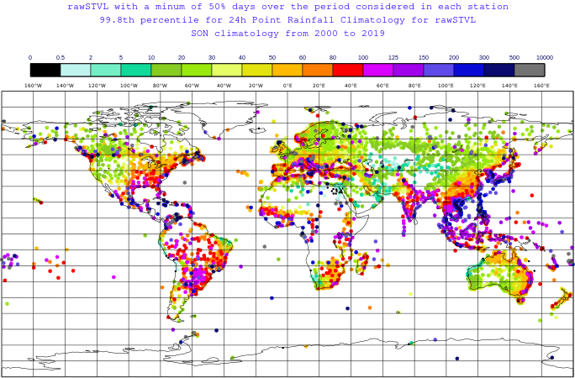
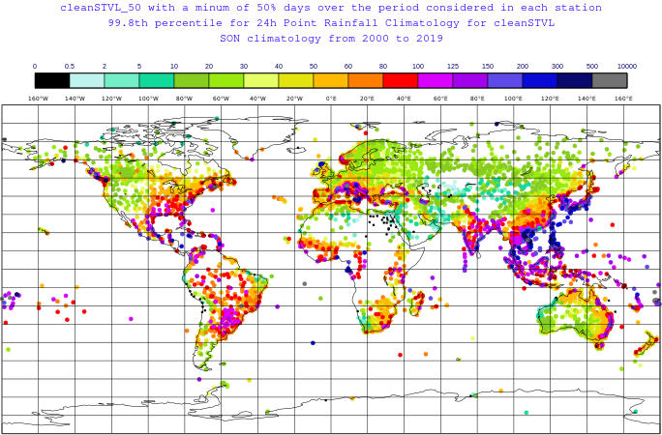
Impacts of the data cleaning using CPC gridded rainfall dataset on the computation of the tail of the 24-hourly rainfall climatology distribution
Areas affected by the data cleaning, gaining a more reasonable representation of true extremes (according to online checks of regional rainfall records).
Areas not affected by the data cleaning.

Slide 6
CONCLUSION
The cleaning was done by multiplying the CPC gridded rainfall totals (provide over grid boxes with 50 km resolution) by a constant factor to quickly transform them so they can in principle be compared with the point rainfall observations provided by the rain gauges.
While the application of a constant multiplying factor is not ideal because it will apply to different weather scenarios (e.g. mainly convective rainfall as opposed to large-scale) in the same way (potentially allowing too many false values in winter when rainfall is mainly large-scale and vice versa in summer when rainfall is mainly convective) the cleaning seems to have addressed a large portion of the issues documented in the raw rainfall observations. In this case (i.e., for the analysis of the tails of rainfall distributions and given the widespread geographical extent of erroneous observations) it is indeed more important to remove as many wrong values as possible and accept that a few correct extremes would also be removed.
This is a rough cleaning that, however, shows the potential of this methodology to quickly clean rainfall datasets that might contain unrealistic rainfall totals. Therefore, it is expected that using datasets such as ecPoint-ERA5 which convert gridded rainfall totals into point-scale in a much more sophisticated way (by applying different multiplying factors according to different weather scenarios) would provide even better results.

